Slide 1


Slide 2

Oracle, HTP, MoHE: Portal & UCM Project
Fenton Travers

Slide 3
Agenda
Progress To Date
Outstanding Items
Demo: Announcements & Desktop Integration

Slide 4
Progress To Date
Development Environment - 95%
  This is key as bugs can be resolved here before they are introduced into production
  We will also use this environment to do all development
Skills Transfer
  Application Development (Portal, UCM, HTML, AJAX)
    2 MoHE staff (Fais&Baizura), 1 HTP (Dewa) – 50%
  Infrastructure Setup (Rahman) – 80%
OpenWCM
  Working to resolve SR with Oracle Support – 75%
Search
  Requirements – 100%, Design – 100%, Development – 30%, Deploy – 0%
Application Integration
  Requirements gathering with business customer(Meeting Manager & FRGS) – 100%
  Design – 50%, Development – 0%, Deploy – 0%

Slide 5
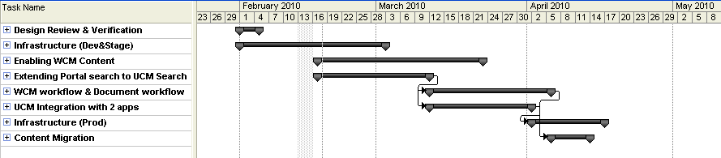
Outstanding Items

Slide 6
Demo: Announcements & Desktop Integration

Slide 7

Questions..
Notes:
SPEAKING POINTS

